Slide 1

Real-Time Pet Tracking and GPS Monitoring System
VIT IEEE SUMMER SCHOOL 2024
TEAM 5

Slide 2
TEAM MEMBERS
Thivya Dharshini S
Sudhiksha N B
Kanike Vinay
Harish R
Gontla Venkata Sai Ketan
Priya Raj
Ankit Kumar

Slide 3

Project Description
The goal of this project is to create a smart IoT-based system that allows pet owners to track their pets in real-time. Whether the pet is inside the house or outside, the system will send notifications to the owner if the pet crosses predefined boundaries and provide GPS-based tracking in case the pet gets lost.

Slide 4

Key Features of Pet Tracking System
Indoor Tracking:
ESP32 (wifi-module) helps detect the pet's presence indoors.
Instant notifications when the pet leaves the house.
GPS Tracking:
Real-time location tracking when the pet is outside.
Crucial for locating a lost pet.
Geofencing:
Virtual boundary around the house.
Alerts sent when the pet crosses the boundary.
Mobile Application and Notification System:
Monitor indoor/outdoor status and real-time GPS tracking on a map.
Manage alerts for when the pet leaves the house or breaches the geofence.
Receive last known GPS coordinates if the pet goes out of range.
Low battery alerts for the pet’s tracking device when running low on power.

Slide 5

REQUIRED COMPONENTS
HARDWARE COMPONENTS:-
->GPS Module:
Component: u-blox NEO-6M or Quectel L80.
Function: Provides real-time location data by connecting to GPS satellites. This is essential for tracking the dog's location when it moves outdoors.
->Wi-Fi Module:
Component: ESP32 (Wi-Fi + Bluetooth).
Function: Allows the device to connect to the home Wi-Fi and check if the dog is within the home network’s range. The ESP32 will be used for Wi-Fi geofencing and can also manage power-saving modes.
Microcontroller (MCU):
Component: ESP32.
Function: The ESP32 will serve as both the microcontroller and Wi-Fi module. It will control the GPS module, manage geofencing logic, and handle communications (alerts via Wi-Fi or SMS via GSM module).
:

Slide 6
GSM Module (Optional):
Component: SIM800L/SIM900.
Function: Provides cellular connectivity for sending alerts (SMS) if Wi-Fi is not available. This can be an additional backup for areas where Wi-Fi signals are weak or when traveling with the dog.
Battery:
Component: 3.7V Li-Po Battery (500-1000 mAh).
Function: Powers the device. Use a rechargeable Li-Po battery with a TP4056 charging module to make the collar more user-friendly. The battery should last for at least a day or two with proper power management.
Power Management:
Component: Implement sleep modes in ESP32 and GPS.
Function: To conserve power, the ESP32 and GPS module should be put into low-power modes when the dog is in a stable location or within the Wi-Fi geofence.
Buzzer/LED (Optional):
Component: Small piezoelectric buzzer or LED.
Function: Provides feedback when the geofence is breached or when the owner needs to locate the dog nearby.
Enclosure:
Component: 3D printed or water-resistant plastic casing.
Function: Holds all components securely in a lightweight and water-resistant case to protect against weather and rough usage by the dog.

Slide 7

SOFTWARE COMPONENTS
Mobile App (iOS/Android):
->The app will notify the owner if the pet leaves the house and track its outdoor location using GPS.
Real-time tracking map using Google Maps API or similar services.
IoT Platform:
->For receiving data and notifications, such as ThingSpeak, Blynk, or a custom solution using AWS IoT or Google Cloud IoT.
Cloud Database:
->To store the pet’s last known GPS coordinates, indoor activity logs, and geofencing data.
Examples: Firebase, AWS DynamoDB, MongoDB.
Geofencing Feature:
->A feature to create a virtual boundary around the house and trigger alerts when the pet crosses this boundary.
MQTT Protocol:
->For efficient communication between the device and the cloud for pushing real-time data.

Slide 8
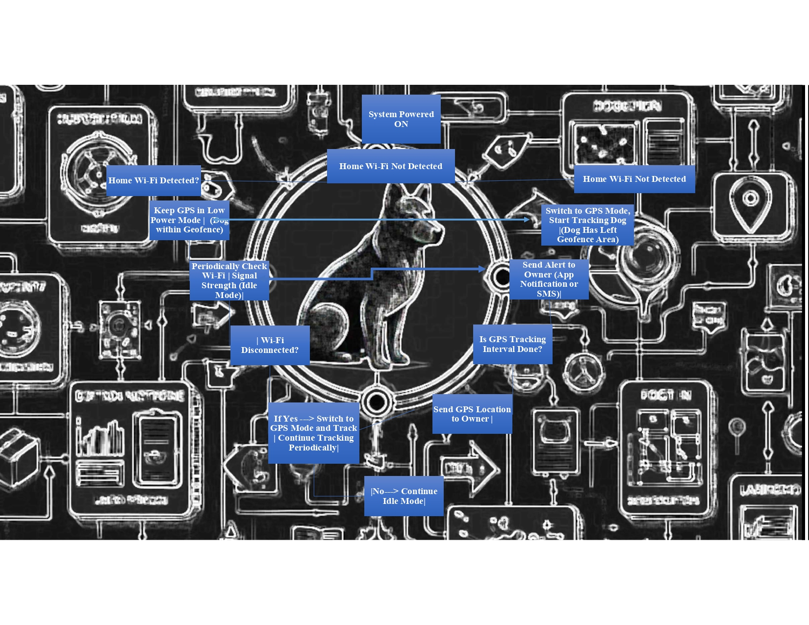

Slide 9
NOVELTY
The novelty of this IoT-based pet tracking system lies in its comprehensive and user-centric approach to pet safety and monitoring.
By integrating both indoor presence detection using ESP32 technology and outdoor GPS tracking, the system ensures pet owners have continuous oversight of their pets' whereabouts, regardless of the environment.
The customizable geofencing feature allows users to set specific boundaries tailored to their living space, triggering instant notifications if these boundaries are crossed.
This, coupled with a user-friendly mobile application that offers real-time updates and data analytics, creates a seamless experience for pet owners..

Slide 10

Cost-Effectiveness:Affordable technology makes pet tracking accessible to a broader audience, providing a budget-friendly alternative.
Low Power Consumption:Optimized ESP32 offers longer battery life, reducing the need for frequent recharging.
Last-Known Location Feature:Provides GPS coordinates when the pet is out of Wi-Fi range, enhancing the chances of locating lost pets.
Scalability and Customization:Easily adaptable for different pets or environments, allowing users to customize the solution.

Slide 11
Benefits of pets tracking device
Enhanced Pet Safety: Continuous tracking reduces the risk of loss or danger.
Increased Owner Peace of Mind: Reduces anxiety about pets' safety through real-time.
Cost Savings: Affordable technology Behavior Insights: Monitoring pets’ movements offers insights for better care and training.
Behaviour Insights: Monitoring pets’ movements offers insights for better care and training.

Slide 12
Community Engagement: Facilitates lost pet alerts and community involvement in recovery efforts.
Integration with Smart Home Ecosystem: Enhances functionality by connecting with other smart devices.
Customization and Scalability: Adapts to multiple pets and diverse ownership needs.
Sustainability: Utilizes low-power devices, contributing to reduced energy consumption.

Slide 13


RISK FACTORS & LIMITATIONS
Privacy Concerns: Sensitive location data could be vulnerable to unauthorized access or breaches.
Wi-Fi Dependence: Tracking effectiveness relies on stable Wi-Fi connectivity; interruptions can hinder performance, especially indoors.
Frequent Recharging: The device may require frequent recharging if not optimized for low power consumption.
Device Failures: Hardware or software malfunctions could result in loss of tracking functionality.
False Alerts: Geofencing may trigger false alarms due to signal interference or inaccuracies.
GPS Signal Issues: Outdoor tracking accuracy may be affected by environmental factors.

Slide 14
CONCLUSION
Real-Time Alerts: Notifies users if their pet is inside or outside the house.
GPS Tracking: Provides accurate location tracking for pets.
Enhanced Safety: Helps prevent pets from wandering too far.
Peace of Mind: Allows owners to monitor their pets at all times.
Responsible Pet Care: Encourages proactive management of pet safety.
Stronger Bond: Fosters a closer relationship between pets and their owners.

Slide 15
Thank You

Slide 16
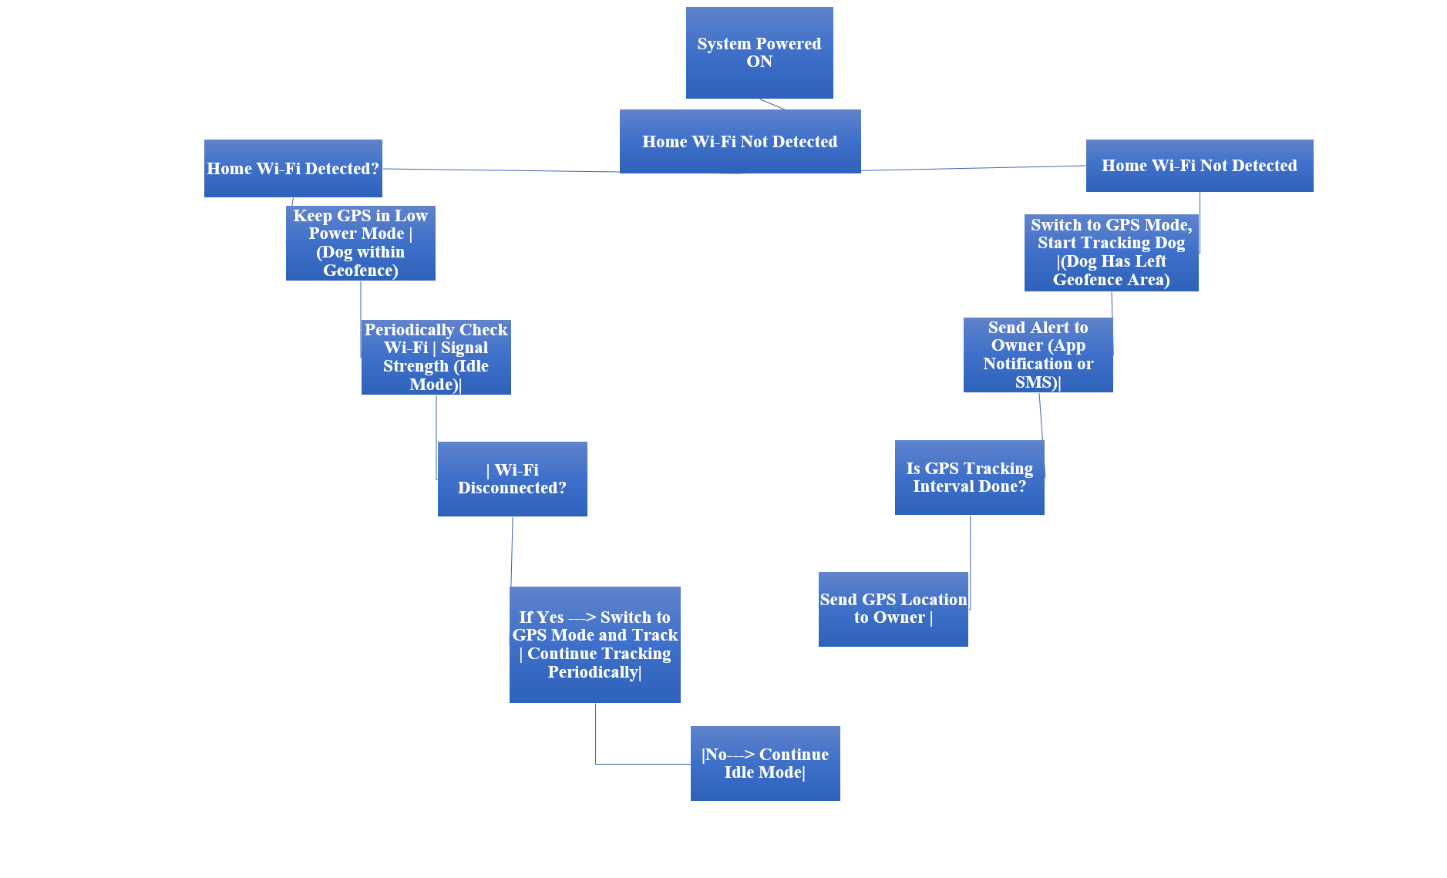

Slide 17


